Slide 1

TA201T: Introduction to Manufacturing Processes I
2020-21 Semester I
Gears
Name: Nikhil Mehta
Roll No: 190549
Section : S3
Tutor: Mr. Tafzeelul Kamal
Instructor: Dr. Anish Upadhyaya

Slide 2
PART 1

Slide 3

GEARS-Introduction
A gear is a toothed wheel designed to transmit torque to another gear or toothed component.
Wikipedia
To prevent their failures, gears should be fatigue free and free of elevated stresses.
Gears should be noise free from fatigue and at constant velocity ratios should ensure high load carrying power.
Due to a lot of reasons manufacturing of gears has been become a specialized subject and we will be having an overview of them in the subsequent slides.
Img : Vectorstock.com/3086577
Notes:
<number>

Slide 4
History and Literature Review
The word gear is probably from North Germanic Language gørvi (plural gørvar) meaning 'apparel, gear,' related, build; to gøra, gørva 'to make, construct set in order, prepare,’.
The earliest gears can be traced back to the Greek mechanics of the Alexandrian school in the third century BC Ptolemaic Egypt and were considerably developed by the great Archimedes
A lot different kind of requirements and a small change in process can whole change the properties has lead to a specialization in manufacturing of gears. This leads to a number of sources and websites where we can obtain the desired information. J.R. Davis book (gear materials , properties and manufacture) helped me to have a great insight to material and research gate website provides a lot examples to learn from.

Slide 5
MATERIAL SELECTION
Strength, durability, and cost are the three fundamental factors for selection of gear material. Other properties include Hardenability and Machinability.
Gears can be manufactured from a whole lot of materials like brass, cast iron but steel is the most common material because it has high strength-to-weight ratio, high resistance to wear and properties can be enhanced using heat treatment.
Many different types of gears with different desirable properties can be made and carburization is one of the method and materials are named such as S15CK, S45C.
Reference Site

Slide 6
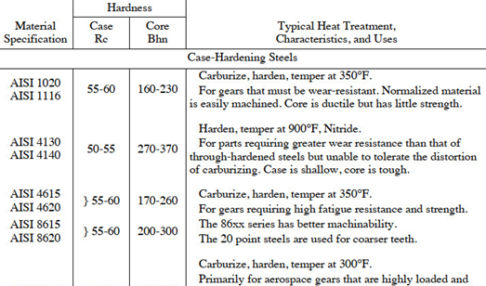
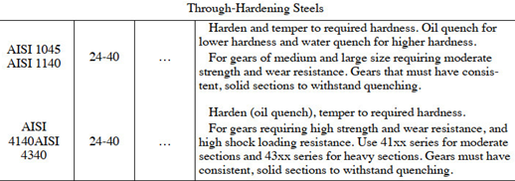
Various Types of Material for gears
This figure provides different types of materials used for manufacturing gears.
This also provides an insight how far ranging properties can be obtained by just heat treatment or changing the carbon content.

Slide 7
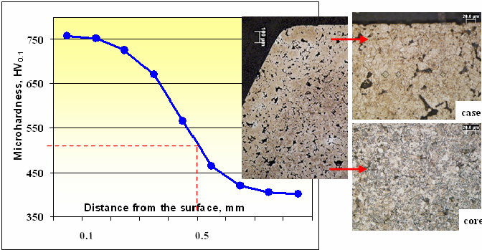
Material structure and Properties
A) Microstructure is of a mixed type because it varies within the body. Thus tooth have differnent microstructure on the surface than the core.
B) Gear steels are used in fine grain form to enhance properties such as yield strength , machinability , fatigue strength etc,.
C) Microstructure is different for different types of alloys . The required average grain size required will be of 6 or 7 micrometer
.
Image
Micro hardness and microstructure of case carburized spur gear.

Slide 8
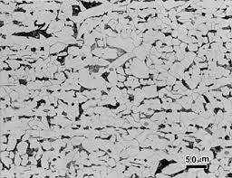
Material structure and Properties
. Generally the properties that are required to be present in the gear steels are –
a)Yield Strength- The yield strength required is different for different type of gear depending on type of application .For example for transmission gears in Postage meters, The Yield Strength required is in the range of 500-600
b) Machinability - The Gear produced from any material should be easily machinable . This means it should have accurate hardenability, and have less number of defects.
Microstructure of Fe Alloys

Slide 9
PART 2
In this we will be covering the methods from which gears can be made. We will be discussing the following :
Powder Metallurgy
Casting :
Die Casting
Sand Casting

Slide 10
By POWDER METALLURGY -
This method is a cost effective alternative to conventional steel.
The P/M process can produce close tolerance gears with strengths upto 1230 Mpa.
This is usually done in 3 steps:
First step includes creating the right blend of the metal powders for durability, reliability and accuracy. Iron nickel steel and prealloyed steel.
Compacting the Mixture to Precise Specifications Under Controlled Pressure.
Heating or "Sintering" to Create a Permanent Form
Reference : Powdered Metallurgy Process Overview | Atlas Pressed Metals
A flowchart for the P/M processing is given in the next slide.

Slide 11
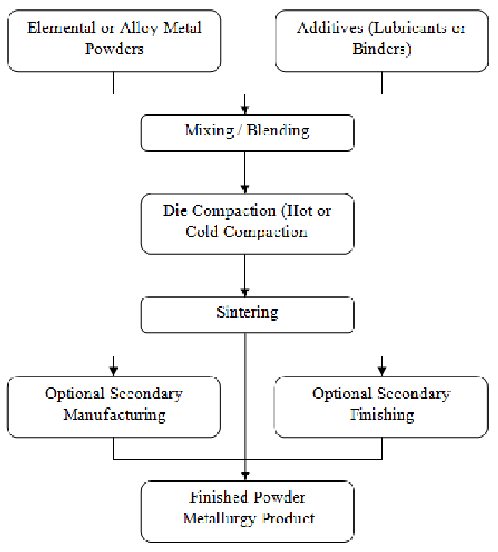
By POWDER METALLURGY -
The chart shown right summarizes the 3 basic processes for Powder Metallurgy.
Reference : Simple Process Flow Chart of Powder Metallurgy. | Download Scientific Diagram (researchgate.net)

Slide 12
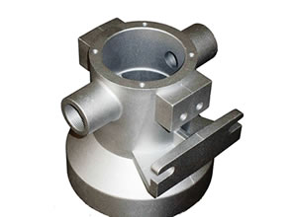
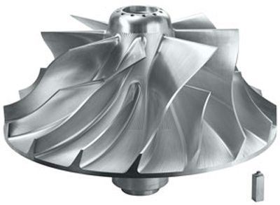
By Casting:
Casting is generally used to make gear blanks or cast tooth gears.
This is recommended for large sized gears as casting gears are many times rough and may have some accuracies.
Gears can be made by using Sand Casting, Investment Casting , but the process that is used often now-a-days is Cold Chamber Die Casting.
In next few slides we would see Sand casting , Investment Casting and also Die Casting.
Titanium Casting

Slide 13
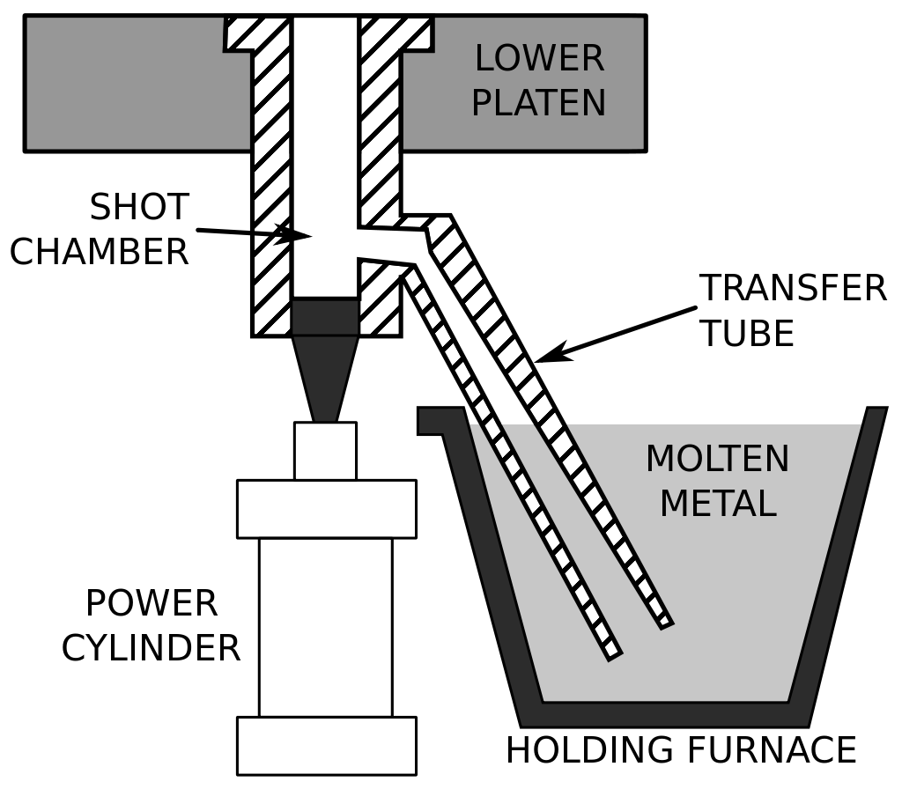
Casting 1 (Die Casting)
This is characterized by forcing molten metal under a very high amount of pressure into a mould cavity and shape of this cavity is similar to an injection molding. It is used manufacture for small sized gears and which are not used for high speeds.
A schematic of a cold-chamber die casting machine.
Source
Example of Materials Zinc, Aluminum and brass

Slide 14
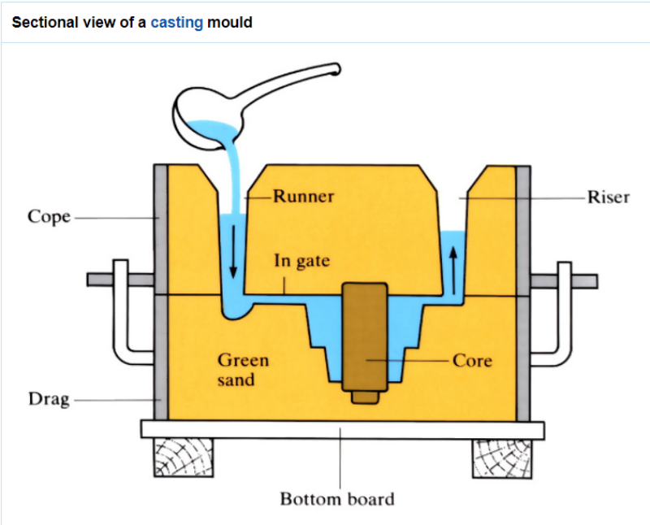
Casting 2 (Sand Casting)
This is just characterized by sand as the mold material.
This includes six basic processes :
A pattern is placed in the mould
Incorporate the pattern and sand in a gating system.
Remove the pattern.
Cavity is filled with the molten metal
The metal is allowed to cool
Sand mold is broken and casting is removed.
Text Reference :J.R. Davis, Davis & Associates Gear Materials, Properties, and Manufacture: pp: 129-131, 2005 ASM International
Image Source

Slide 15
References
J.R. Davis, Davis & Associates Gear Materials, Properties, and Manufacture: pp: 129-131, 2005 ASM International
http://www.stanfordmaterials.com/titanium-ti-casting-products.html
B.L. Ferguson , Forging Of powder Metallurgy Gears, May 1980.
Micro hardness and microstructure of case carburized spur gear. | Download Scientific Diagram (researchgate.net)
Wikipedia : Link 1, Link 2
https://khkgears.net/new/gear_knowledge/gear_technical_reference/gear_materials.html
Mikell P. Groover , Fundamentals Of Modern Manufacturing, Chapter 16 ,Wiley,2010

